Slide 1
Progress Summary
Mar 31st 2023
Youfu Qian

Slide 2
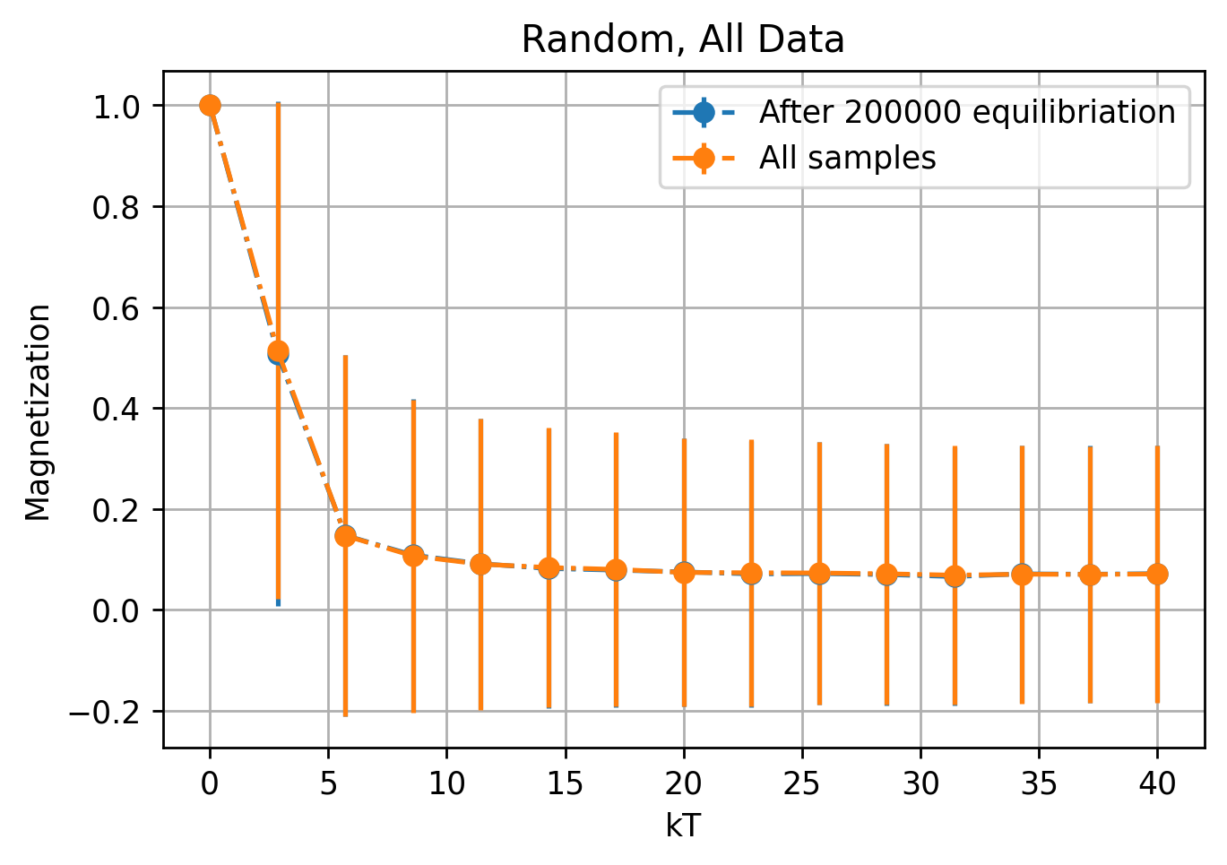
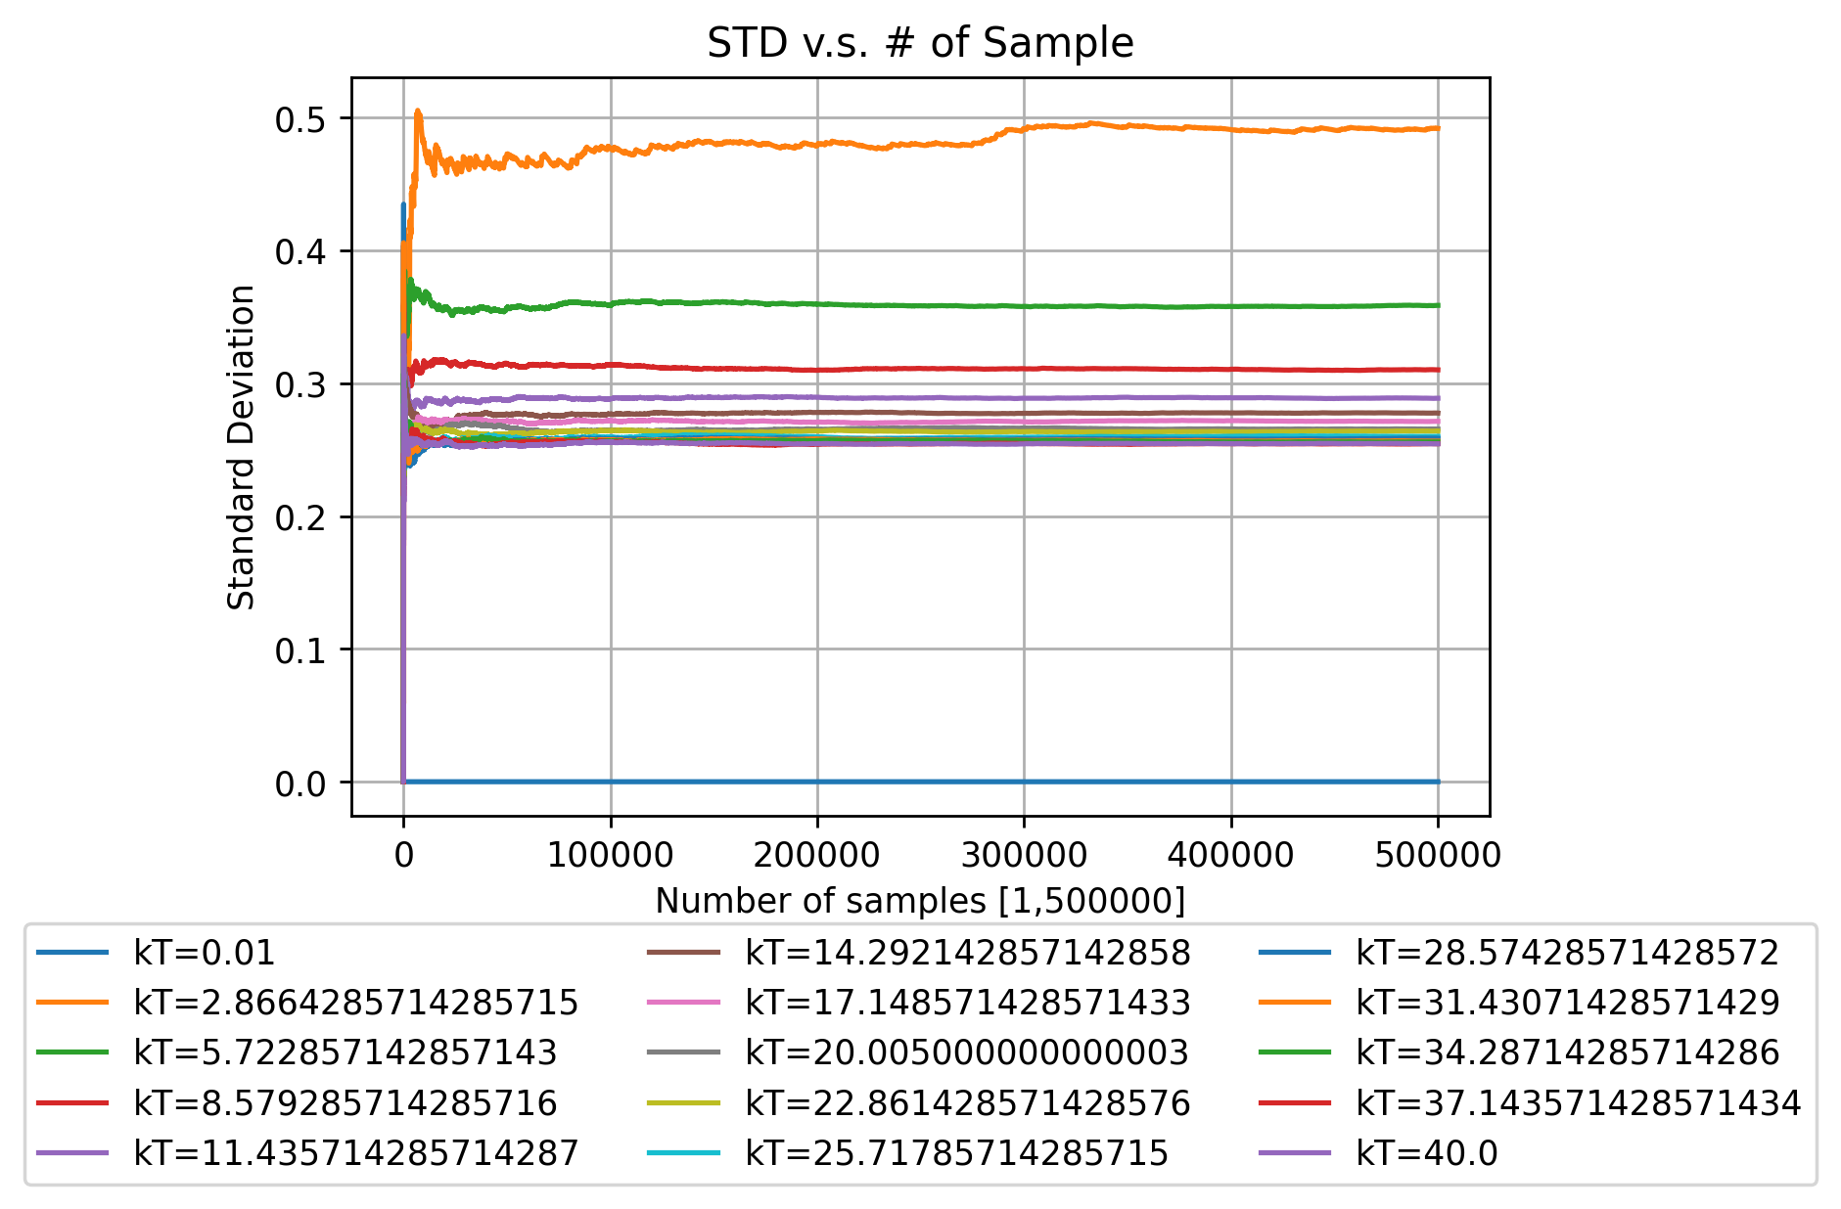
Vijaya’s classical results

Slide 3

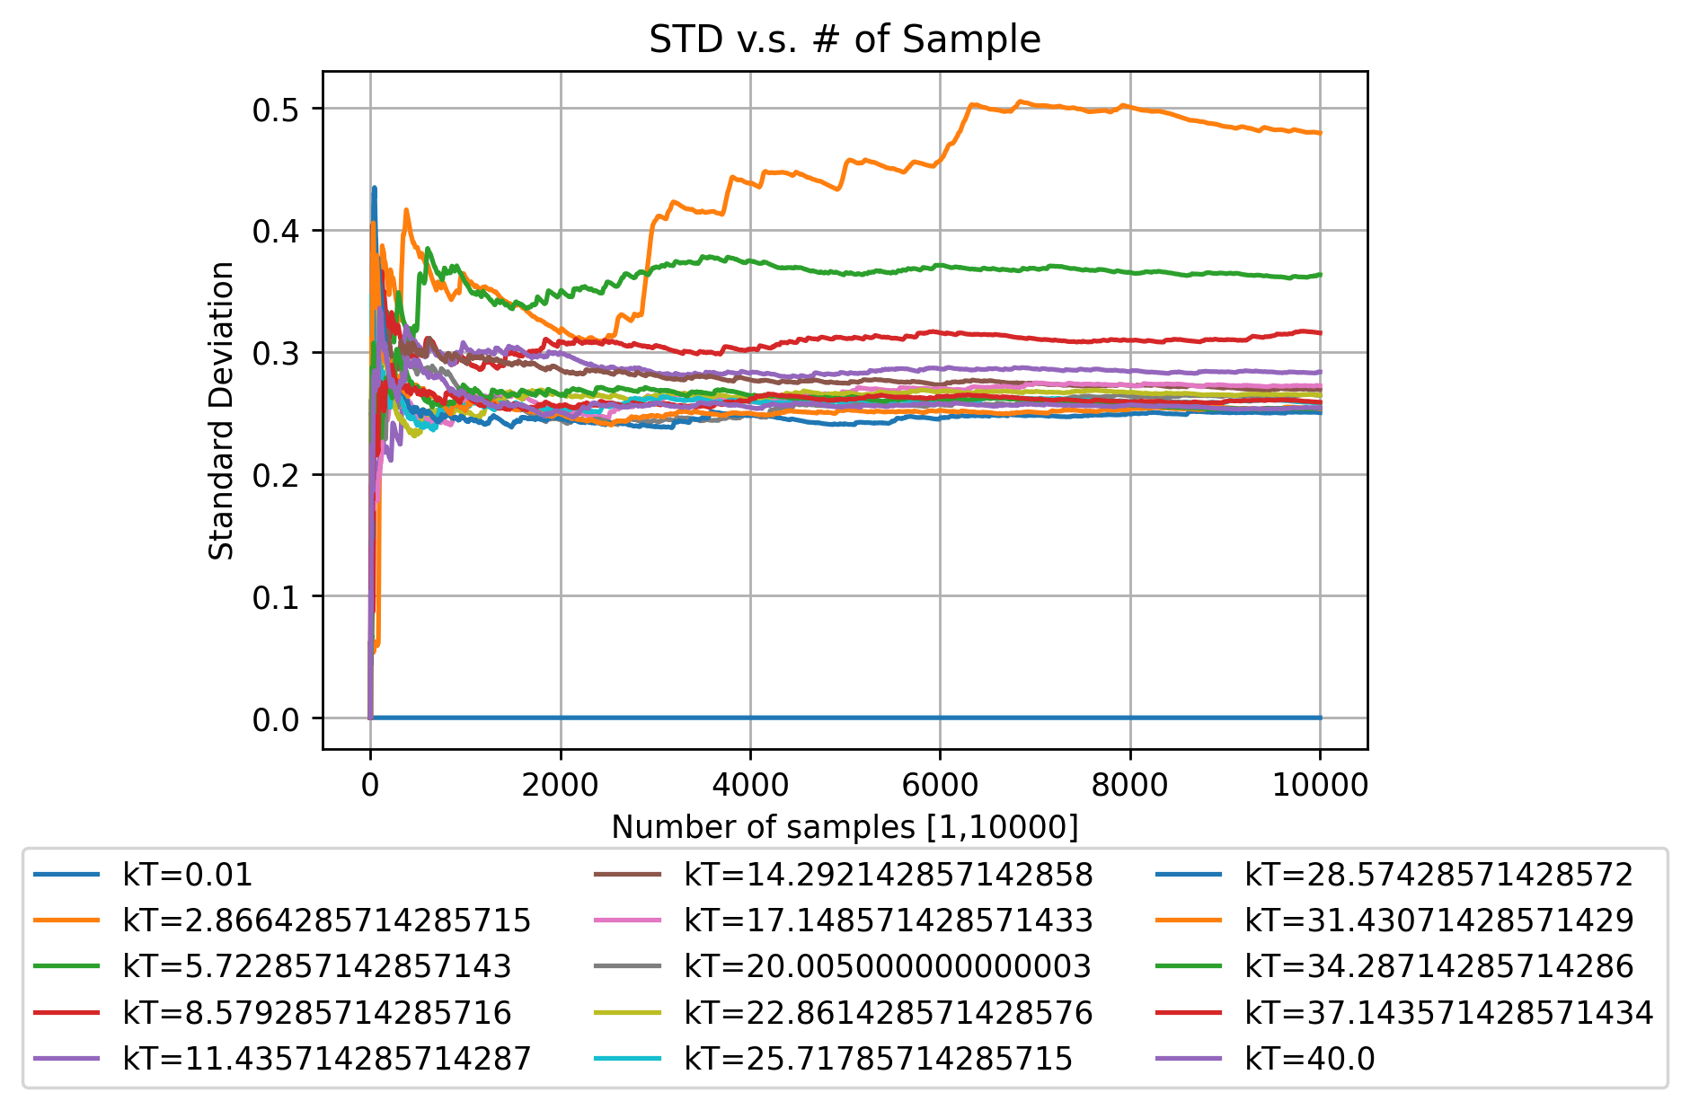
Vijaya’s classical results (only first 10000 iterations)

Slide 4
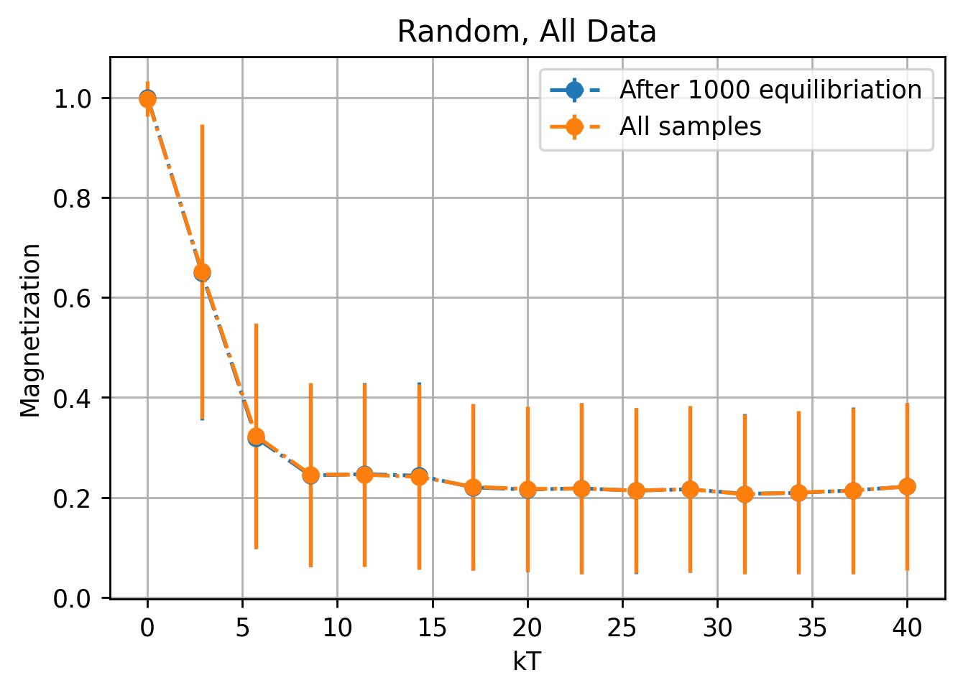
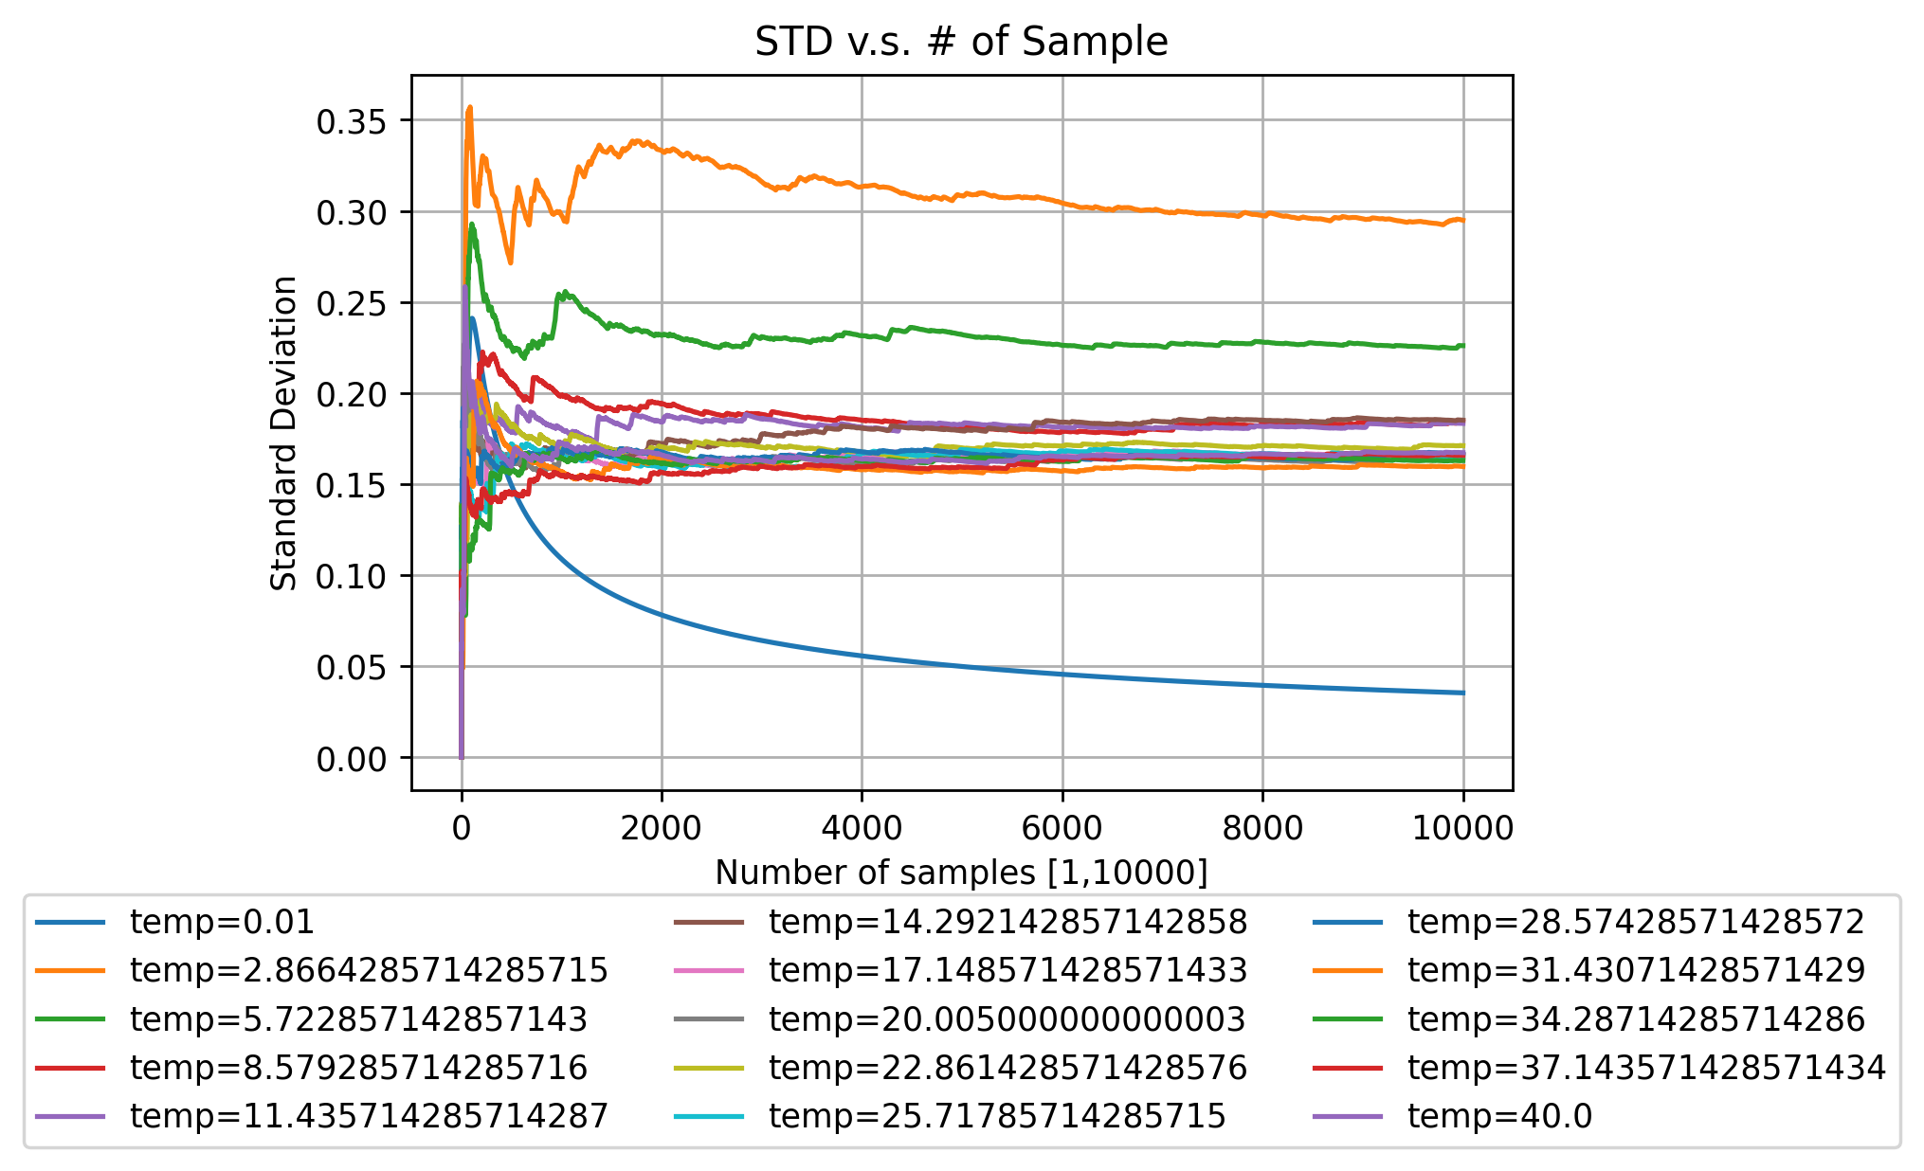
Using the last result as the next starting point

Slide 5
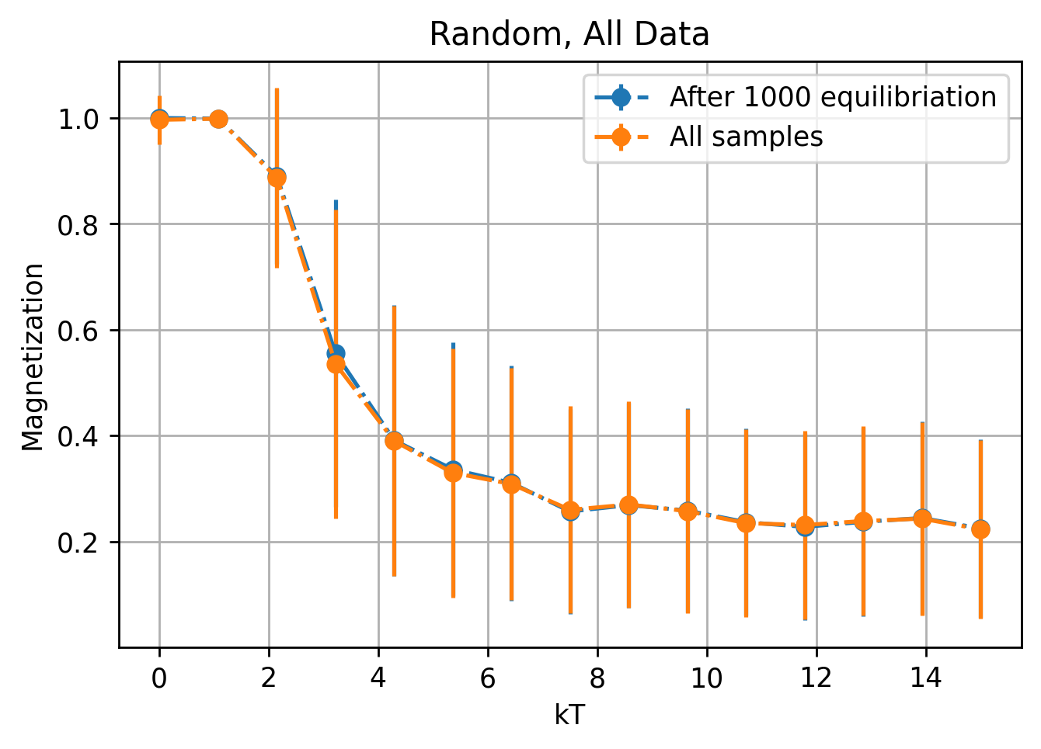
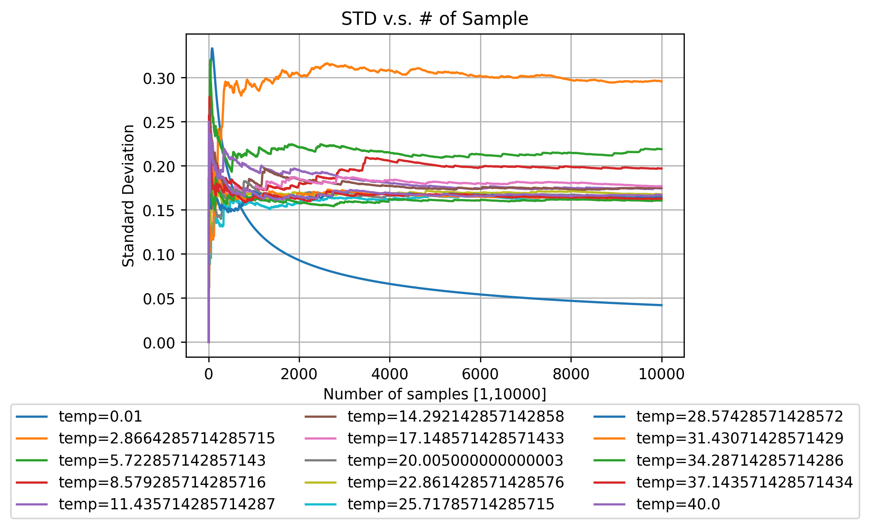
Using the last result, kT = [0.01, 15]

